Slide 1
Predictive Analytics for Patient Outcomes
In this project, I am looking to resolve an issue based on assumptions from a Medical Corp. Based on a Diabetes dataset that was previously collected, some Medical staff said that a positive test of Diabetes is related to the Body Mass Index(BMI).
As a Data Analyst, I wanted to evaluate the assumptions and run advanced analytical techniques to ensure data-driven conclusions.

Slide 2
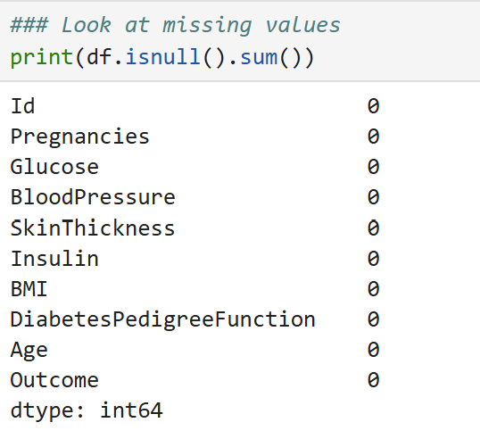
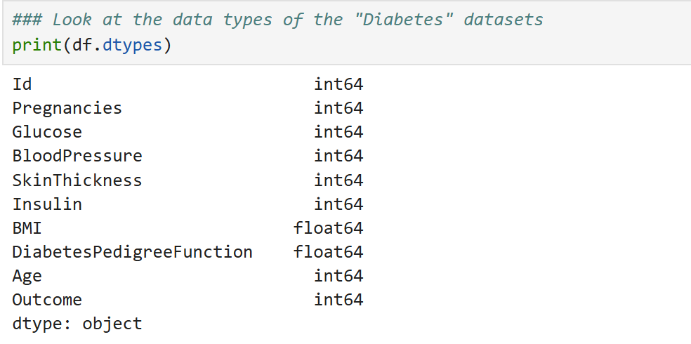
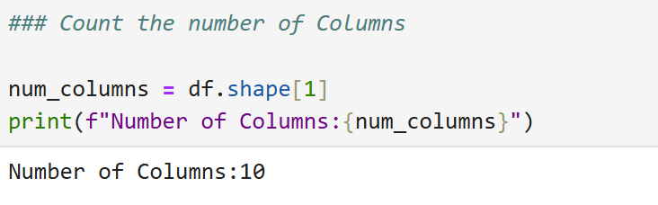
Exploratory Data Analysis
In this analysis, I have a Diabetes dataset that contains 10 variables. Below is the list of the following variables with no missing values in either one.
However, some variables such as BMI, Blood Pressure, Insulin, Skin Thickness, Glucose contain 0 values which do not make sense. I have to replace the 0 values with the Mean Value.

Slide 3
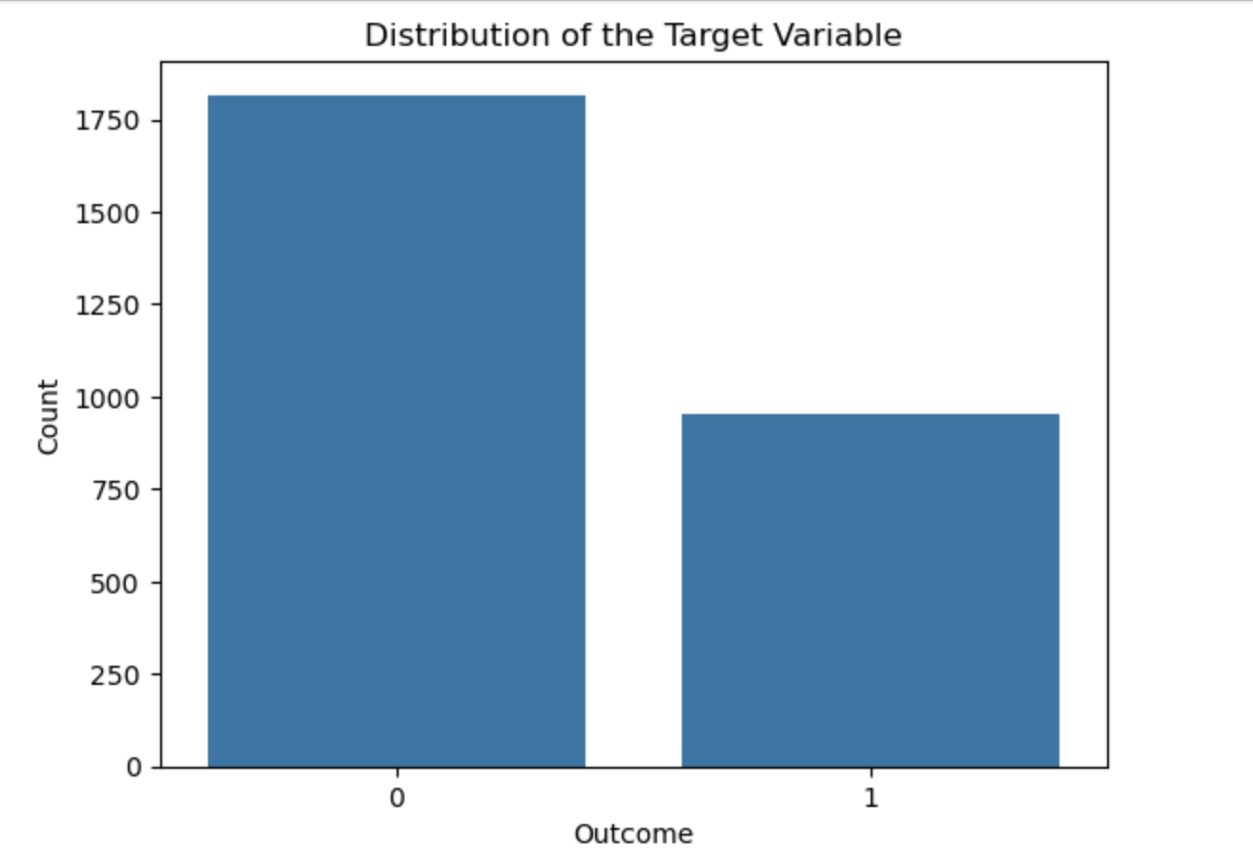
The outcome variable has two values. - 0 is Non- Diabetes - 1 is Diabetes

Slide 4
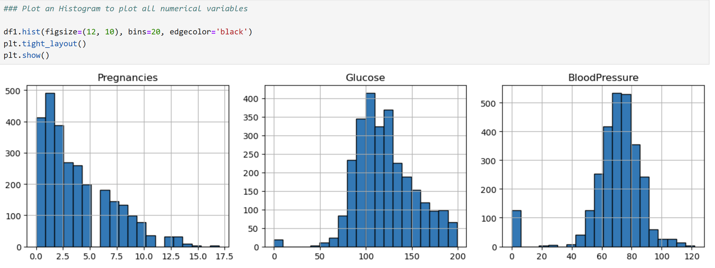
The histograms for the numerical variables show the shape of the numerical variables

Slide 5
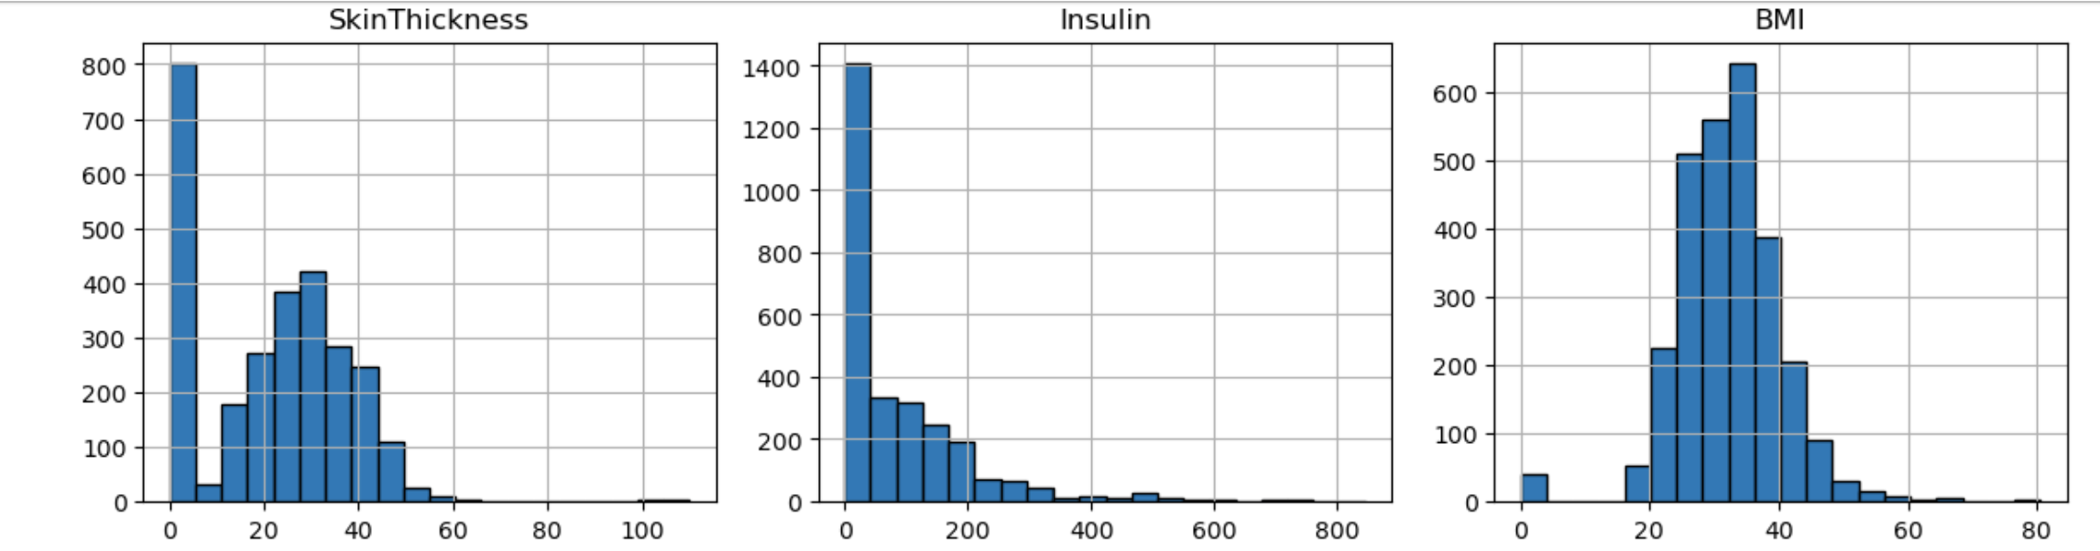
The histograms for the numerical variables

Slide 6
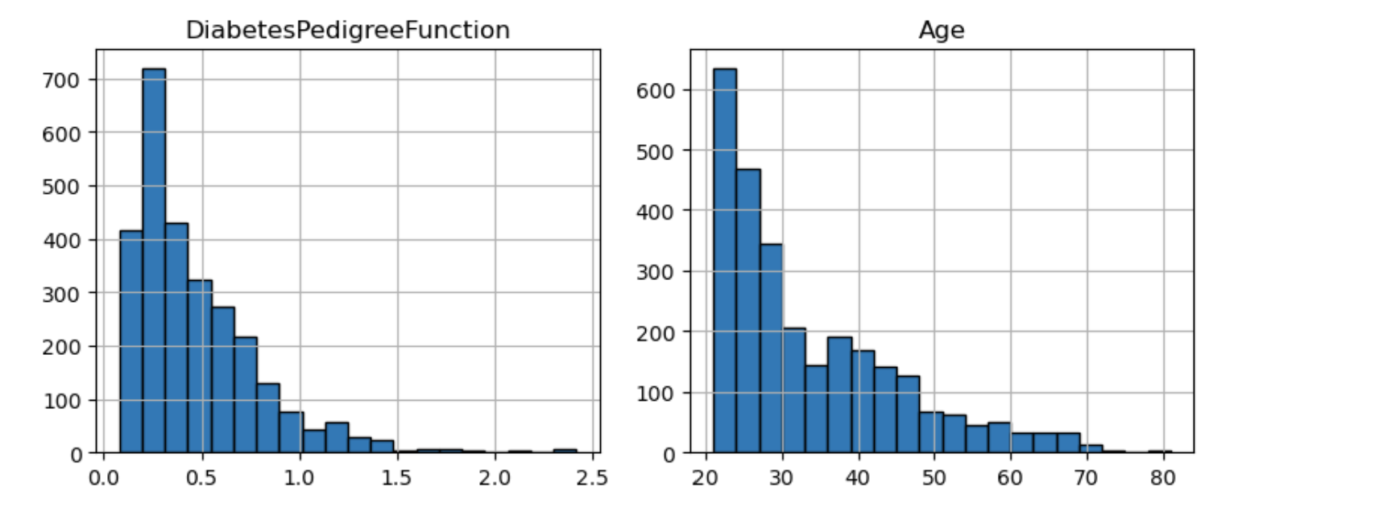
The histograms for the numerical variables

Slide 7
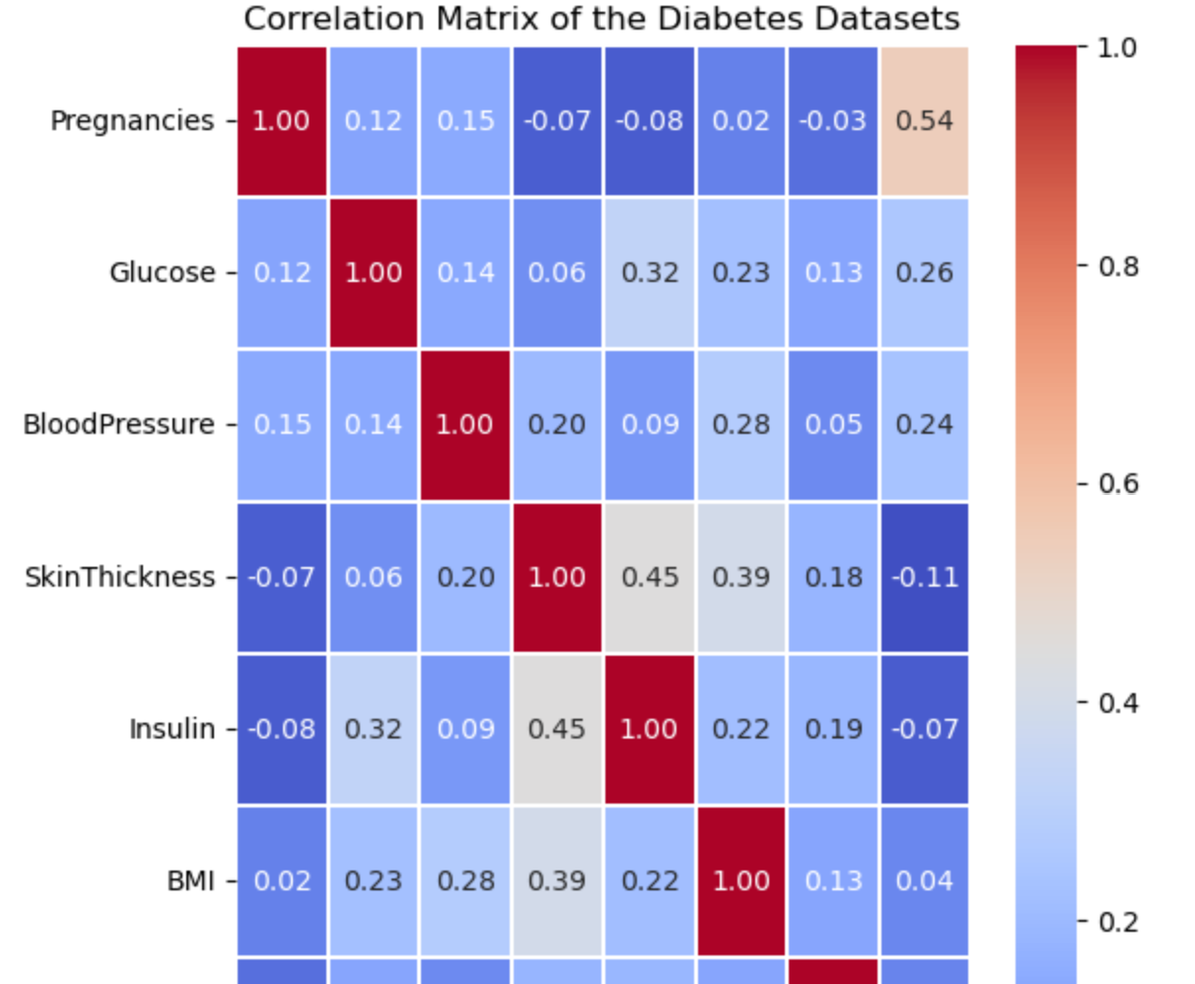
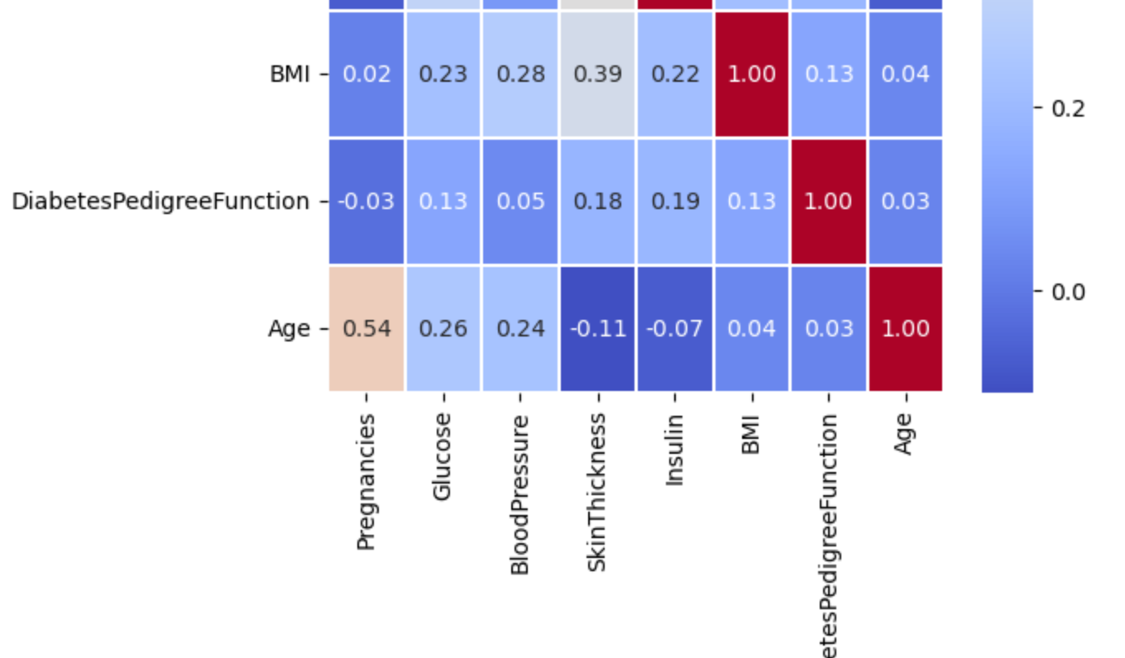
Correlation Matrix shows the numerical variables that have a relationship among them and how strong their relationship is.

Slide 8
Statistical Analysis
While the medical staff said that a positive Diabetes test is more associated with the BMI, I will have to use a T-test and look for a significant difference in means to verify that assumption.
In this case, a two-sample T-Test is necessary because the target variable has Diabetic and No-Diabetic values. I will create two groups and look at their mean values to conclude if there are statistically significant different.
As a T-test must complete the basic requirements. Normality and Homogeneity of the datasets must be checked.

Slide 9
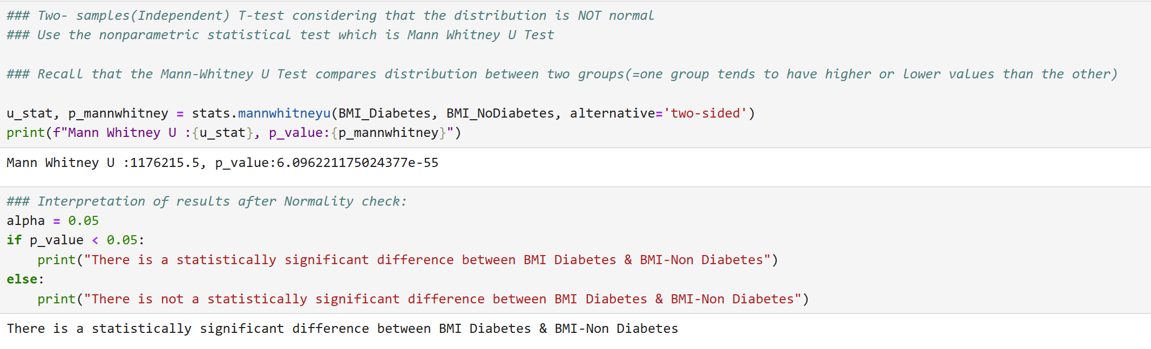
Normality check

Slide 10
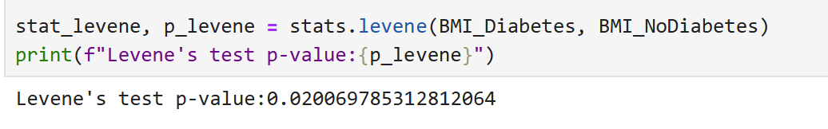
Homogeneity check
Checking the homogeneity of BMI implies finding that the p-value is less than 0.05. That means if after running p- levene function, the p-value is < 0.05, then homogeneity is confirmed as an existing assumption. If not, the T-test function will be run with the “Welch’s T-Test function” that does not assume the homogeneity.

Slide 11
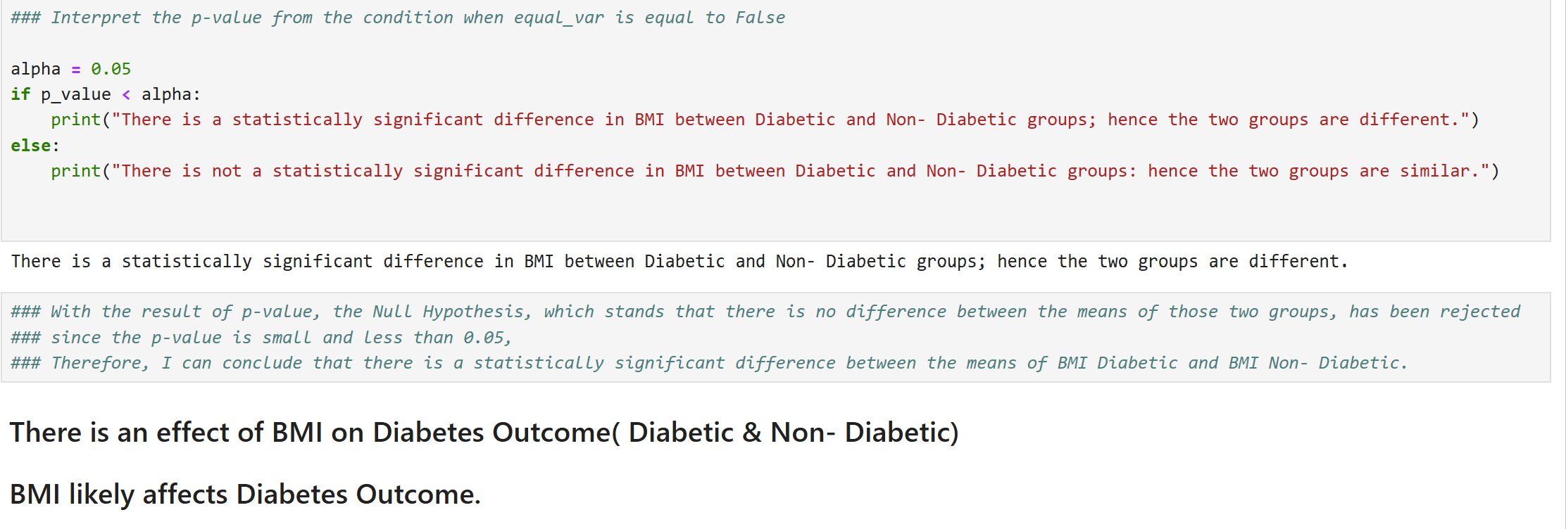
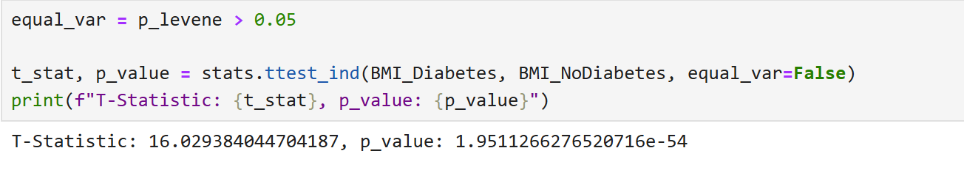
Welch’s T- test
As the p-value for the homogeneity is less than 0.05, the T-test to use for our case is Welch’s T-test, and it will consider that Homogeneity does not apply.
Therefore, with the result of the two-sample T-test, I found out that BMI likely affects Diabetes outcome as the p-value is less than 0.05.

Slide 12
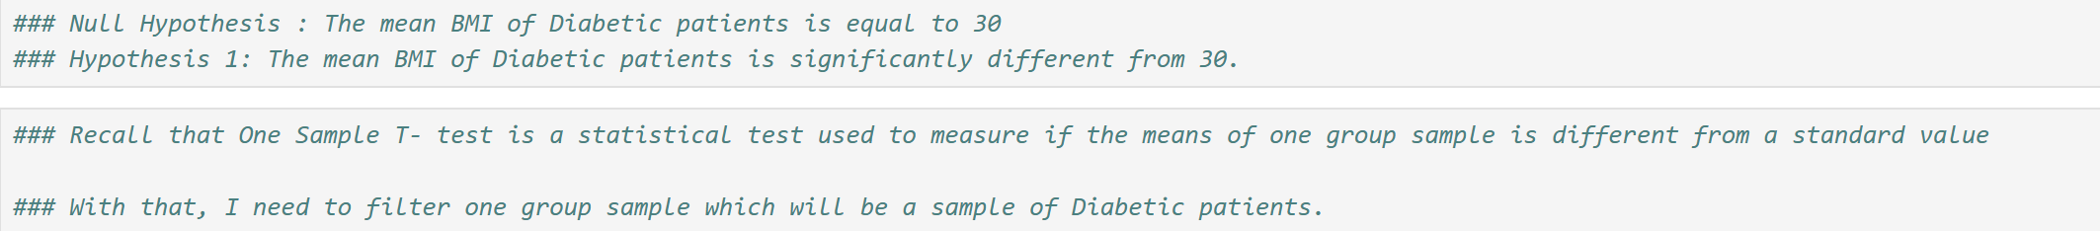
Another assumption from the Medical Staff arose
After presenting the result of the two-sample T-test, another assumption arose that Diabetic people have a BMI greater or equal to 30.
As a Data Analyst, I had to run an One- sample T- test to verify that assumption. One sample T-test because there is a standard value of 30 for the BMI and the Outcome variable that will ONLY consider the value 1 “ Diabetic”.

Slide 13
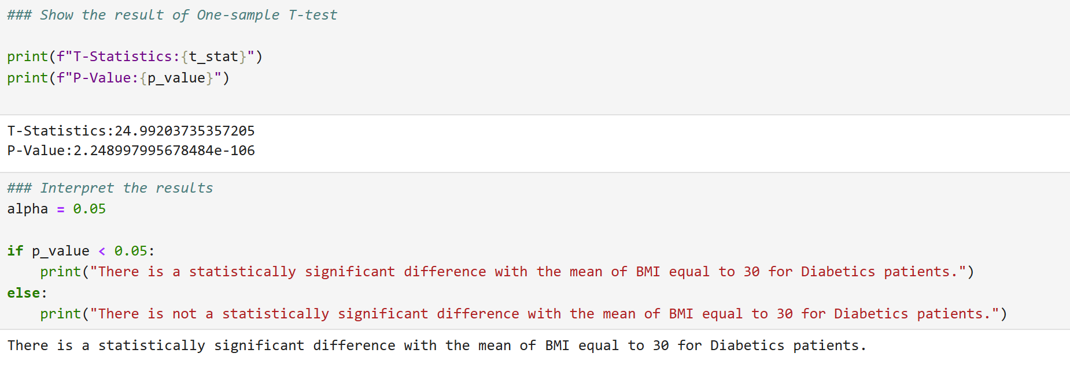
As a result, the null hypothesis that says that Diabetic people have a BMI equal to 30 is rejected.

Slide 14
Likelihood of a positive Diabetes Test for a new patient
As a result of One sample T-test was out, the Director of the Diabetes Center Treatment came back with another question. She wanted to predict the likelihood of diagnosing a positive Diabetes Test.
As a Data Analyst, I prepare the datasets to train a Logistic Regression model and predict the likelihood of having a positive Diabetes Test.
The dataset was partitioned into Training Datasets and Validation Datasets, and then the model was built on Training Datasets.

Slide 15
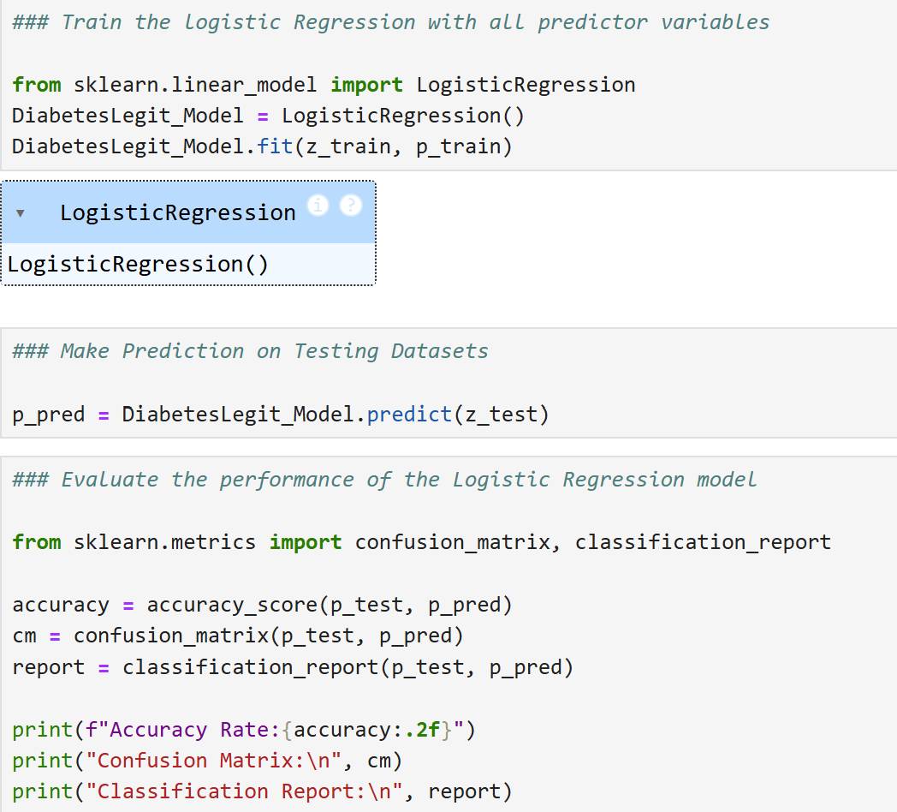
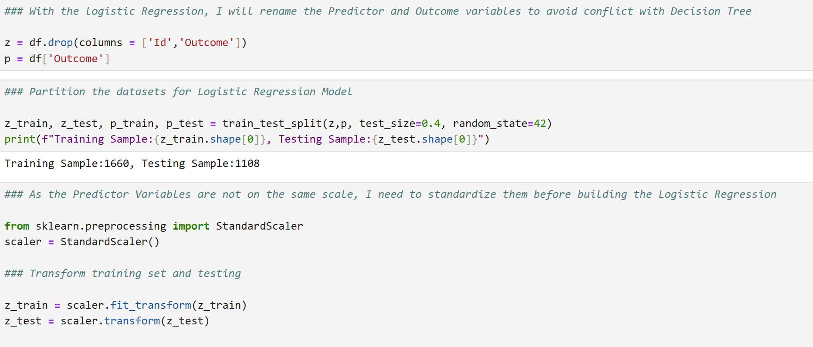
Logistic Regression Model

Slide 16
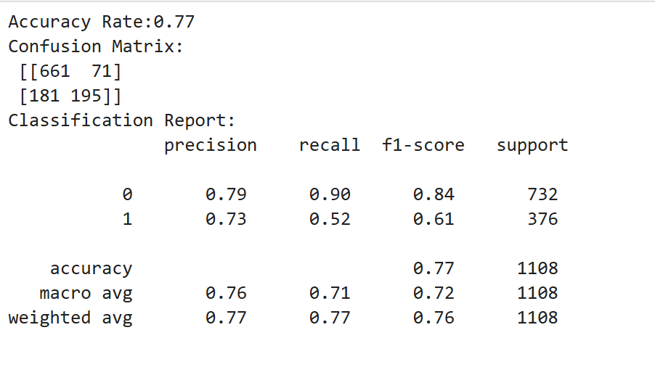
Logistic Regression- Evaluation Performance
The Recall of the Logistic Regression is equal to 52%, that means the Sensitivity is also equal to 52%. This is the ability to detect the important class, which is the Diabetic value in the Outcome.

Slide 17
Decision Tree Model
As the Logistic Regression was built and is performing at a low rate, I would need to train another model and evaluate its performance compared to the previous model. The model is a Decision Tree.
Note that the Decision Tree model is also trained after partitioning the datasets to avoid overfitting. The model is built with the largest dataset, which is the Training Datasets, and the prediction and the model performance will be done on the Validation datasets.

Slide 18
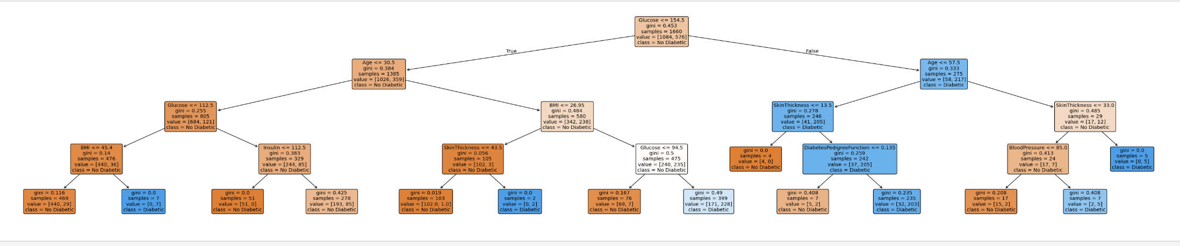
The Result of the Decision Tree Model

Slide 19
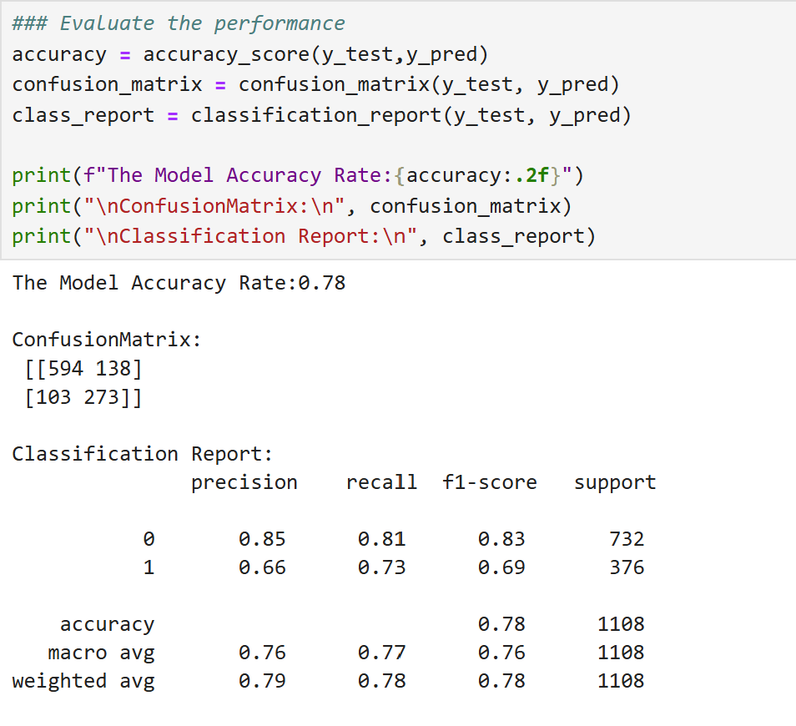
The Decision Tree Performance Evaluation gives the ability to predict a positive test for a new test equal to 73%. This is Recall also known as Sensitivity.

Slide 20
Recommendations
For this predictive analytics for patient outcome, I would suggest using the decision tree model as the better performing model to classify the result of a new test( future patient).

